Slide 1
Uncertainty Quantification of Agent-based Models with Application to Malaria Intervention Modeling
PhD Update
Aug / Sep 2025

Slide 2
Individual and community protection
At what coverage level does each malaria intervention (LLINs, IRS, SMC, malaria vaccine) begin to provide community-level protection (eg., reduced malaria prevalence among non-recipients), and how do these thresholds vary across transmission settings in Ghana?
Direct protection causes a roughly linear increase early on.
Community protection (indirect effects) shows up as nonlinear acceleration.
The threshold where slope starts increasing more rapidly is a good proxy for community-level protection starting to matter.

Slide 3
Background
There is an urgent need to deprioritize malaria interventions due to the declining funding
The effectiveness and cost effectiveness of these interventions have been used to prioritize interventions in the past
To be able to assess the effectiveness of these interventions, their broader effects throughout the population should be considered, including among those not directly receiving the intervention
Recent research highlights the growing body of evidence for these indirect effects across malaria control tools, emphasizing their importance for both research and policymaking
We aim to assess indirect protection using mathematical modeling to help with prioritizing malaria interventions

Slide 4
community protection focus
Focus on one district – Biakoye in Oti
Simulate interventions separately ie. vary one intervention (0, 0.2, 0.4, 0.6, 0.8, 1) and set the other to its current coverage value
LLIN deployed starting 2021, 2024, 2027
SMC deployed from 0to5 July to October, starting 2023
CAPP calculated for individual interventions
Vary both interventions (0, 0.2, 0.4, 0.6, 0.8, 1) at the same time
Calculate cases averted per person protected (CAPP)

Slide 5
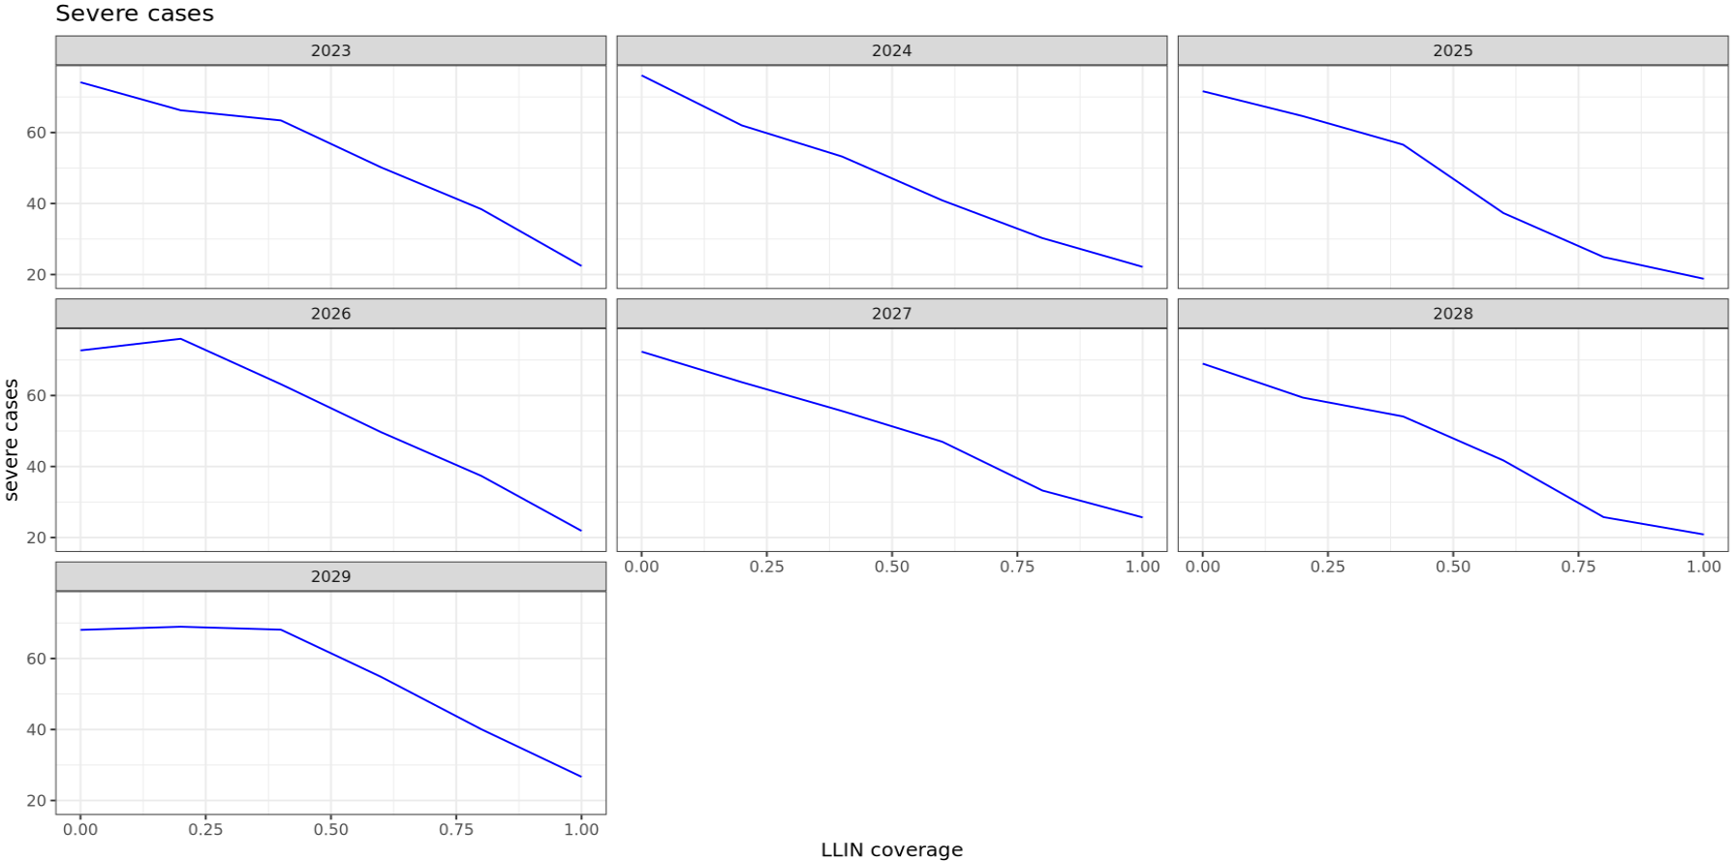
Severe Cases across LLIN coverage levels

Slide 6
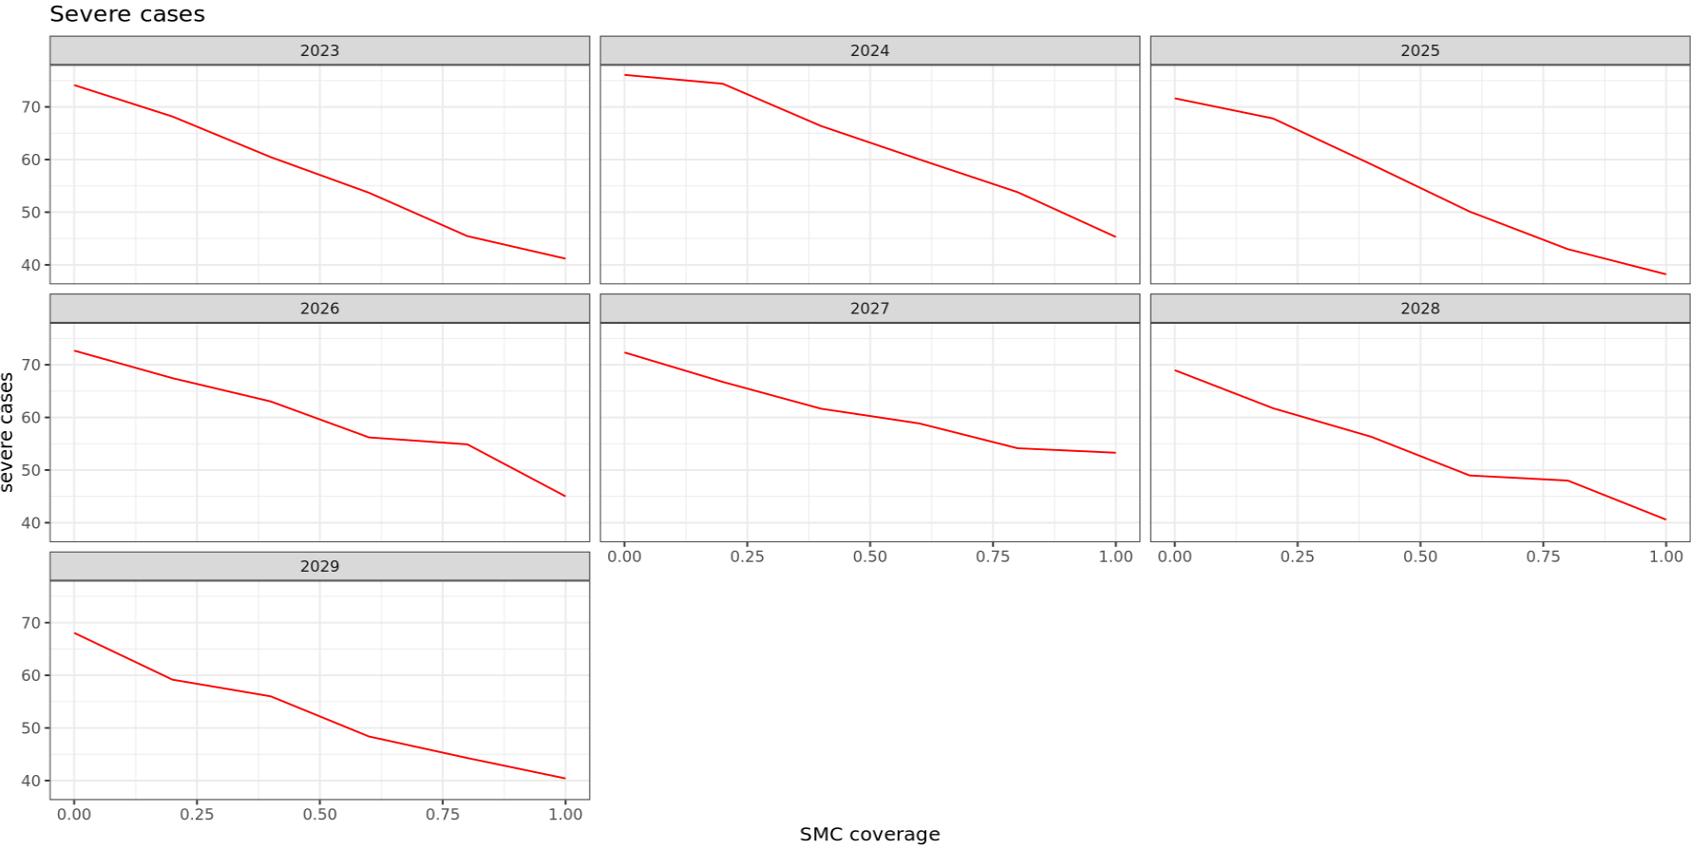
Severe Cases across SMC coverage levels

Slide 7
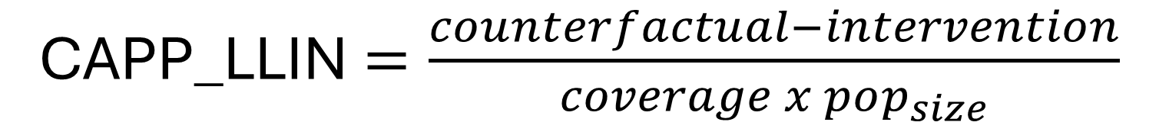
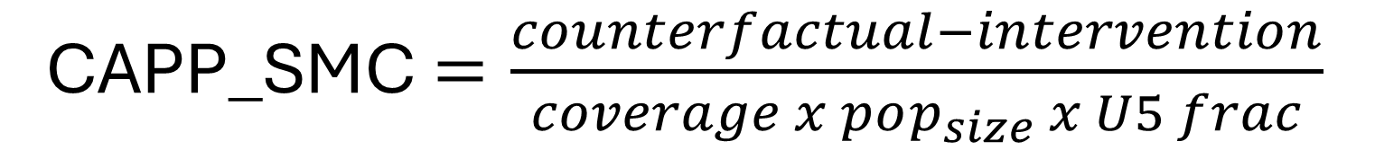
Cases averted per person protected
CAPP_LLIN $=\frac{counterfactual−intervention}{coverage x pop_{size}}$
CAPP_SMC$=\frac{counterfactual−intervention}{coverage x pop_{size} x U5 frac}$
Pop_size = 10000

Slide 8
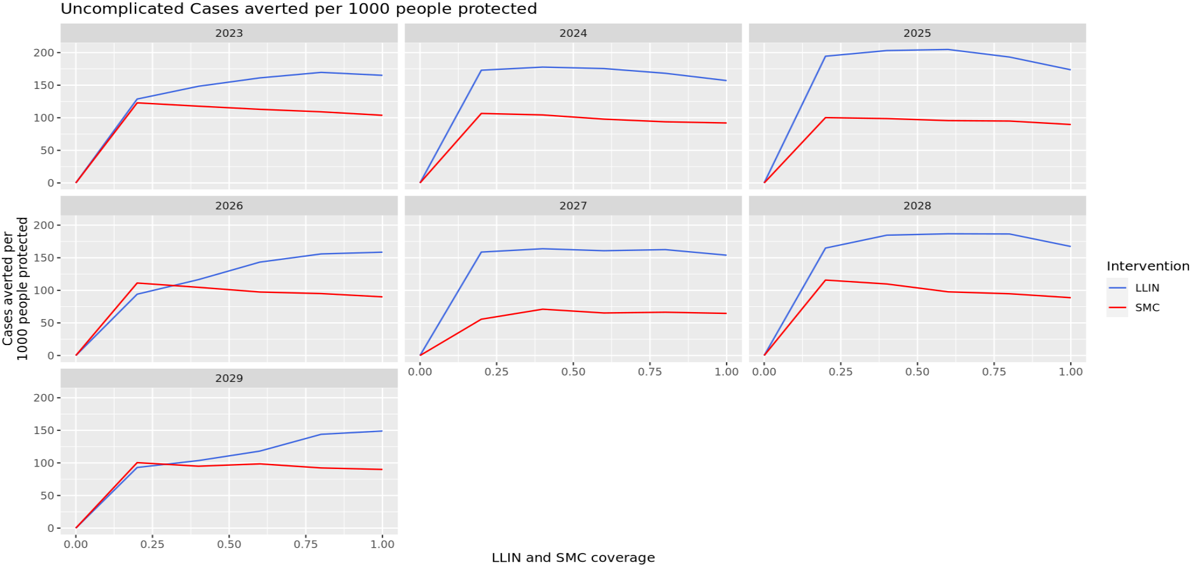
Uncomplicated Cases averted per 1000 people protected

Slide 9
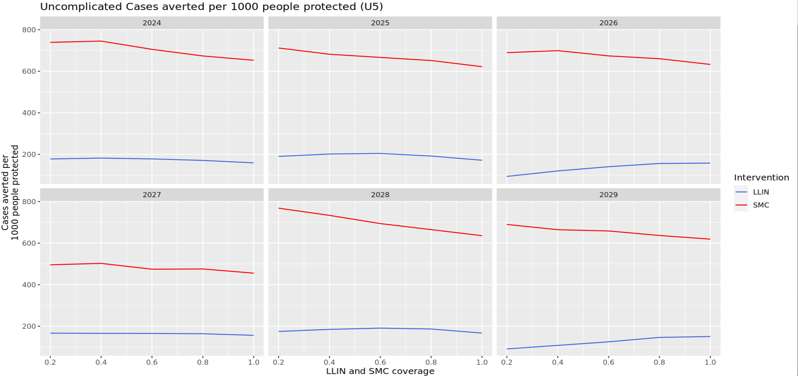
Uncomplicated Cases averted per 1000 people protected in U5s

Slide 10
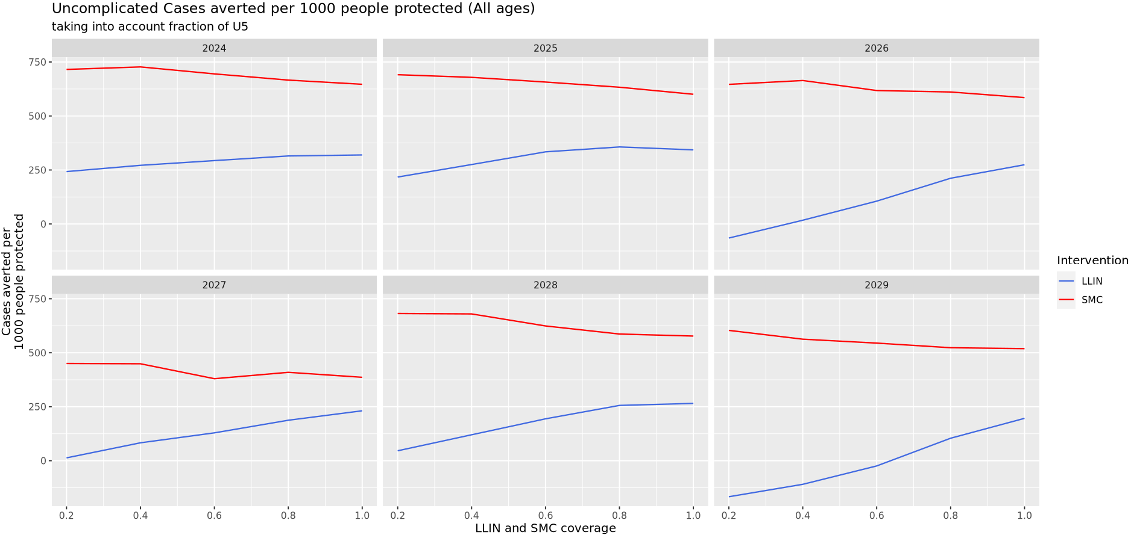
Uncomplicated Cases averted per 1000 people protected in 0-100

Slide 11
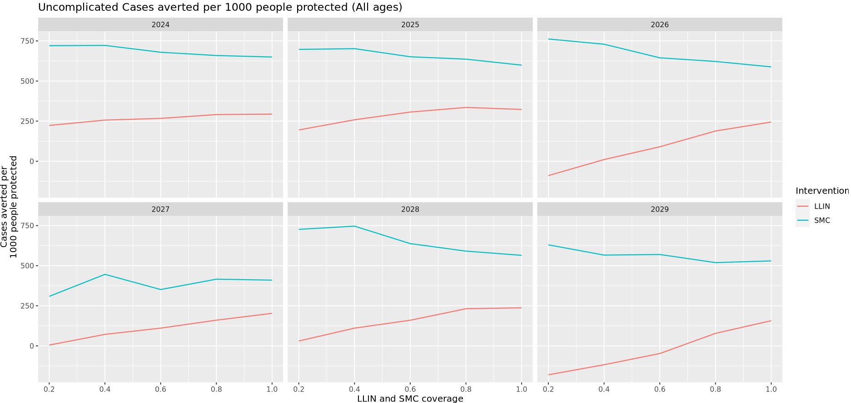
Uncomplicated Cases averted per 1000 people protected in 0-100

Slide 12
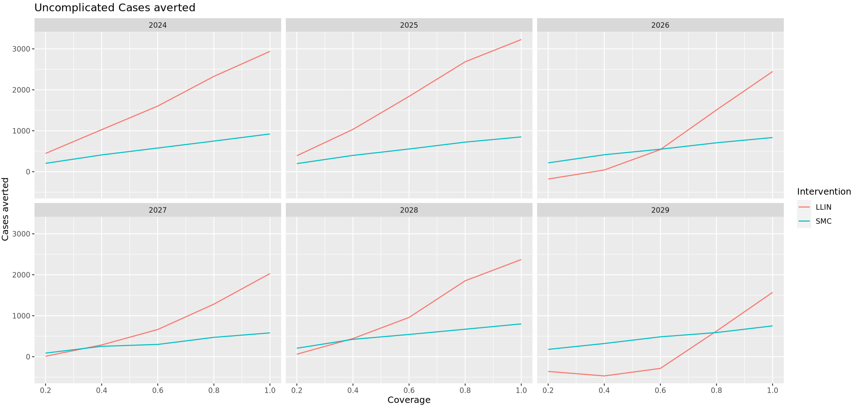
Uncomplicated Cases averted in 0-100

Slide 13
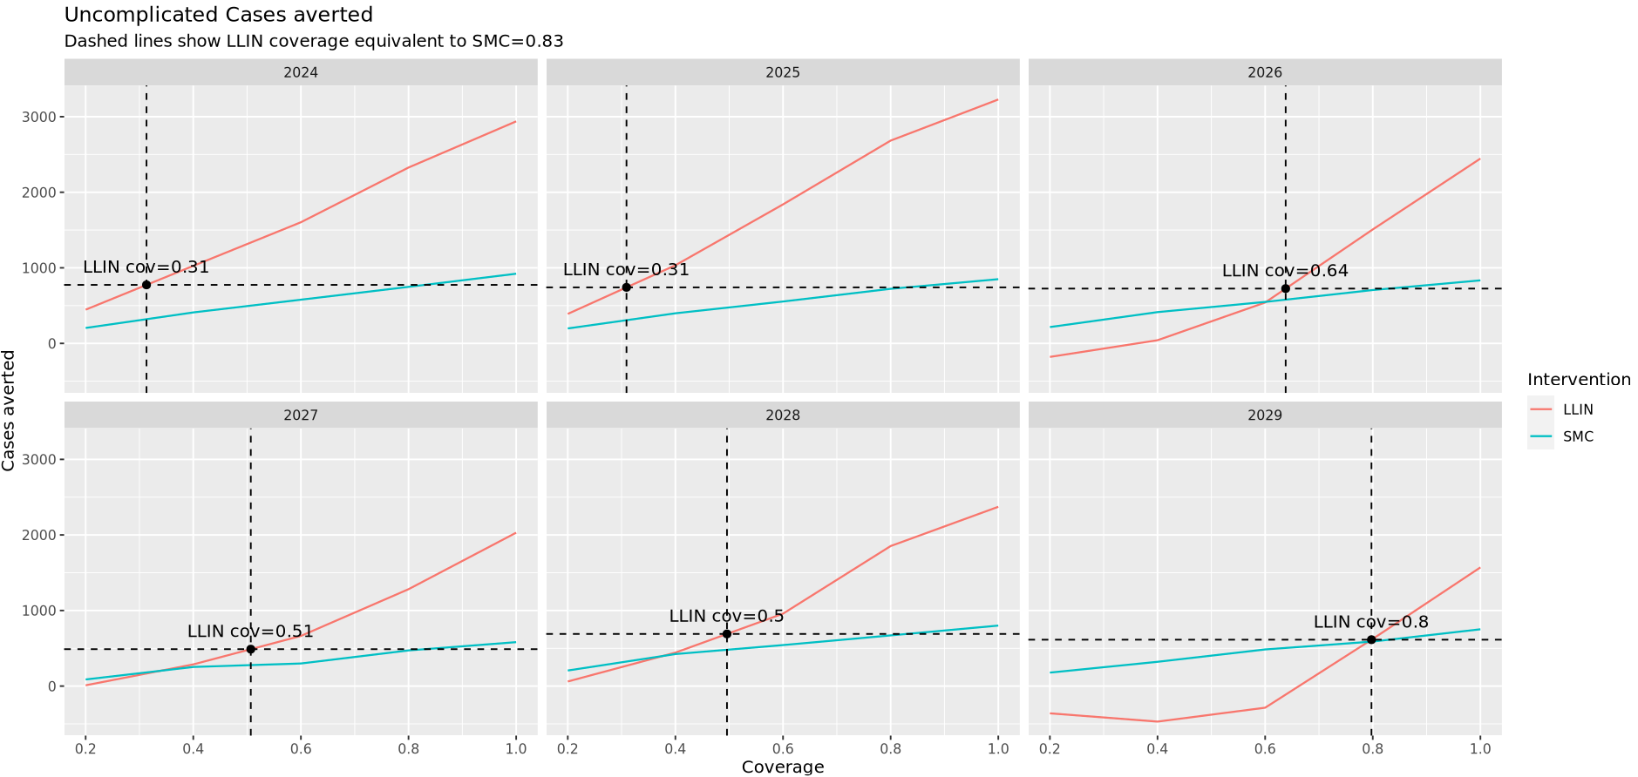
SMC equivalent LLIN coverage in 0-100

Slide 14
Cost of LLIN to achieve SMC-equivalent impact in 0-100
People protected
SMC (85% of under-5s, where under-5s = 14.2% of 10,000 = 1,420)
0.85×1,420=1,207
Unit costs
SMC: $1.50 per cycle × 4 cycles = $6.00 per child per year
SMC total cost
1,207×6 = $7,242
People protected
LLIN (30% of 10,000)
0.30×10,000=3,000
Unit costs
LLIN: $2.00 per net, 2.5 people per net
-> 2/2.5 = $0.80 per person protected
LLIN total cost
3,000×0.80 = $2,400
To avert the same number of cases:
  LLIN (30% coverage) costs $2,400
  SMC (85% coverage) costs $7,242
So LLIN is roughly 3 times cheaper to achieve the same impact.

Slide 15
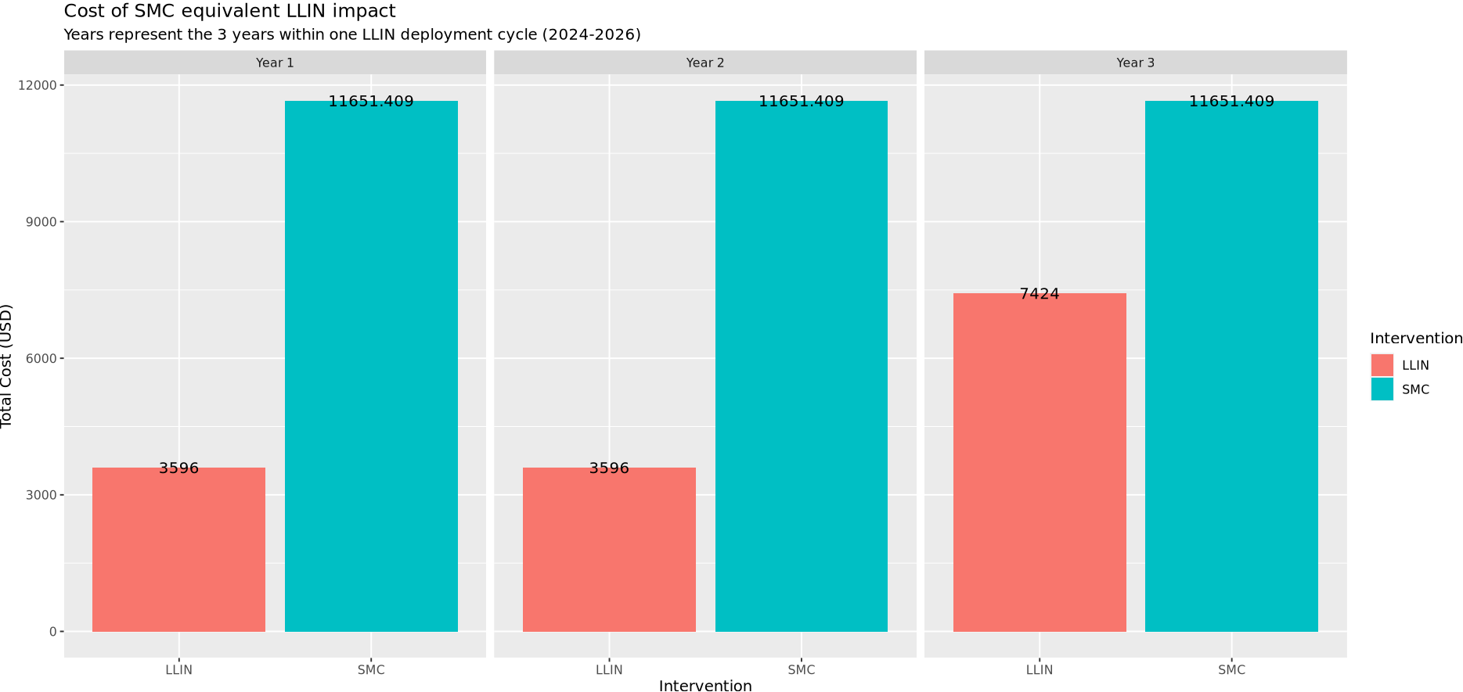
Cost of SMC equivalent LLIN impact in all ages
LLIN is roughly 2 times cheaper
LLIN is roughly 3 times cheaper
LLIN is roughly 3 times cheaper

Slide 16
Regression analysis
This analysis will allow us to summarize and quantify the average relationship between coverage, EIR, and cases averted, rather than relying on raw curves from individual simulations.
Here, we built an explanatory model using the simulated data to reveal and quantify this relationship
Model:
Cases averted = b0 + b1 *coverage + b2 * coverage^2 + b3*EIR + b4*(coverage x EIR) + ε
This equation assumes that the uncomplicated cases averted by an intervention (ie. LLIN / SMC) is the sum of some base level (b0), contributions of coverage of the intervention (b1), the square of the coverage (b2), the transmission intensity (b3) and of the interaction between coverage and transmission intensity (b4), and a random normally distributed quantity (ε)

Slide 17
Regression analysis
b1 – direct effect of coverage
b2 – indirect effect of coverage
This will allow to quantify the average uncomplicated cases averted by an intervention (ie. LLIN / SMC) at a given coverage and transmission intensity as:
E[Cases averted] = b0 + b1 *coverage + b2 * coverage^2 + b3*EIR + b4*(coverage x EIR)

Slide 18
Regression analysis - Data
Data structure for analysis
Simulation results were collated into a single dataset with identifiers for year, random seed, EIR level, and coverage level.
Restricting the analysis to the period 2024–2029 (representing two cycles of LLIN distribution) allowed focus on medium-term impacts after intervention scale-up.
Each row in the dataset represents one simulated outcome under a given scenario, seed, and EIR level.
Number of obs = 105...
Cases averted = continuous

Slide 19
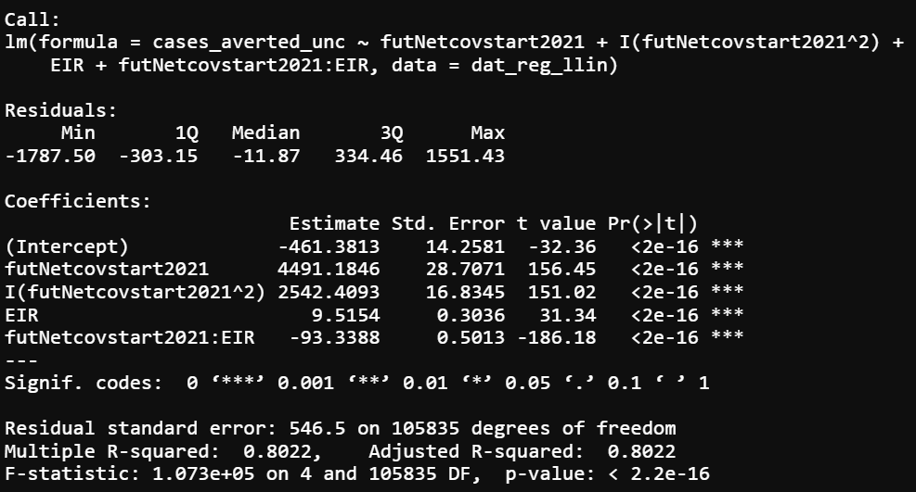
Regression analysis – Simple Linear regression - LLIN

Slide 20
Regression analysis – Coefficients - LLIN
 | Estimate | Interpretation
Intercept | -461 | At zero coverage & zero EIR, predicted cases averted ≈ -461
Coverage (direct effect) | +4491.4 | Each unit increase in LLIN coverage (0-1 scale) is associated with 4491 cases averted
Coverage (indirect effect) | +2542.4 | Positive curvature implies as coverage increases, the impact accelerates (non-linear benefits)
EIR | +9.5 | Higher EIR implies more cases averted
Coverage × EIR | -93.3 | at higher EIR, the marginal benefit of increasing coverage is smaller. (Indirect protection saturates faster under intense transmission)

Slide 21
Coefficients – Interpretation in the context of indirect protection
LLIN coverage strongly reduces malaria cases, with a convex (accelerating) relationship.
Baseline transmission (EIR) matters: higher EIR increases absolute cases averted (more to prevent), but the efficiency of nets per unit coverage declines in very high transmission settings.
This captures indirect protection dynamics:
  At low/medium EIR → indirect (community) protection amplifies coverage impact.
  At very high EIR → mosquito pressure overwhelms nets, so coverage gains taper off.

Slide 22
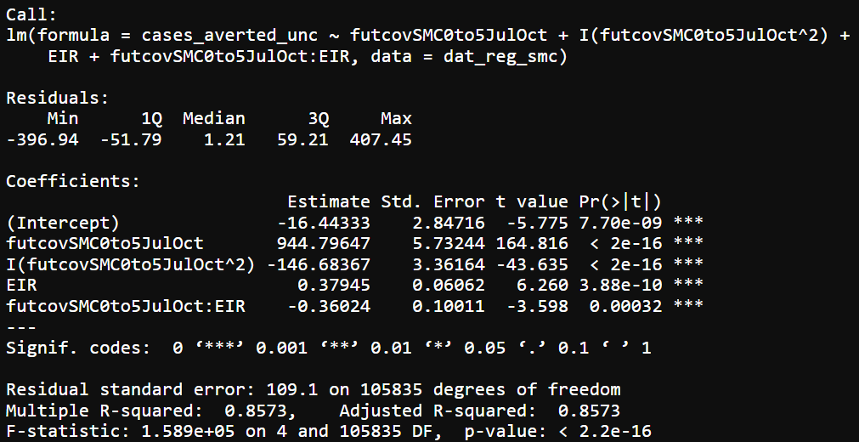
Regression analysis – Simple Linear regression - SMC

Slide 23
Regression analysis – Coefficients - SMC
 | Estimate | Interpretation
Intercept | -461 | At zero coverage & zero EIR, predicted cases averted ≈ -16
Coverage (linear effect) | +944.8 | Each unit increase in SMC coverage (0-1 scale) averts ~945 cases. Much smaller than LLIN effect because SMC only targets children 0–5 years
Coverage (quadratic effect) | +146.7 | Negative curvature implies diminishing returns at higher coverage. The first increments of SMC coverage avert the most cases; gains flatten at high coverage
EIR | +0.38 | At higher EIR, slightly more cases are averted, but the effect is modest
Coverage × EIR | -0.36 | Negative interaction: at higher EIR, the marginal benefit of increasing SMC coverage decreases (similar to LLIN but much weaker)

Slide 24
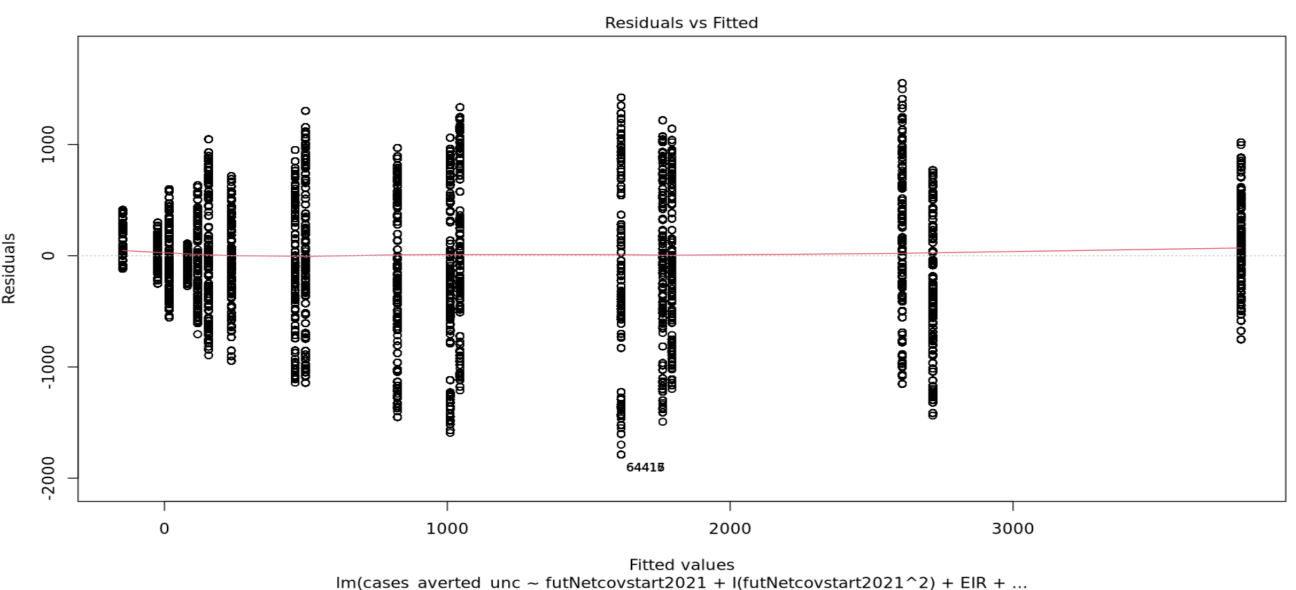
Simple Linear regression - Linearity assumption -LLIN

Slide 25
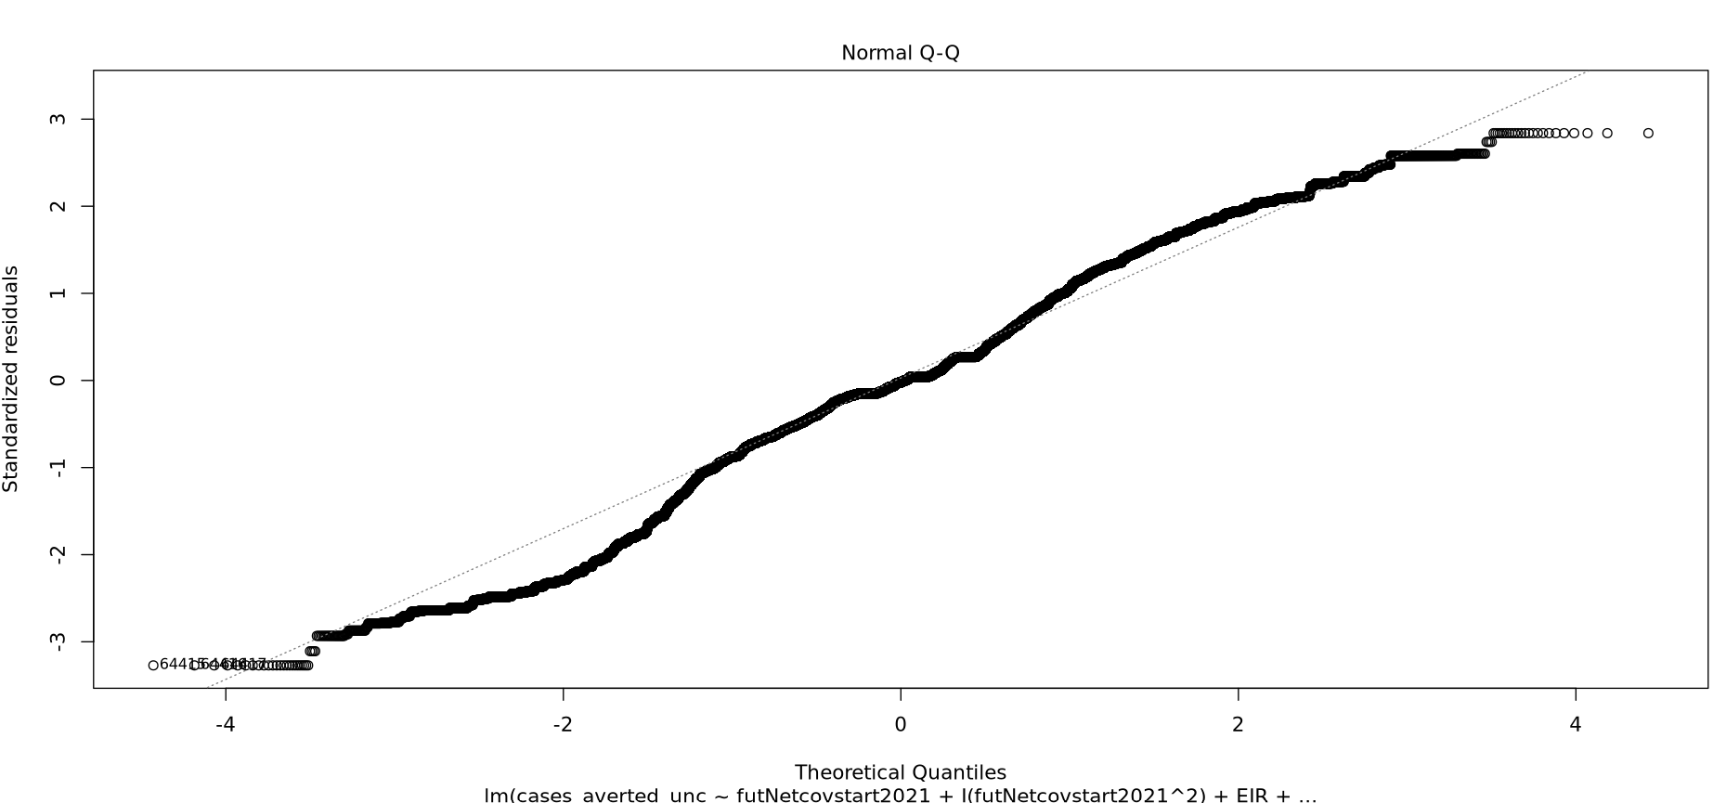
Simple Linear regression – Normality assumption - LLIN

Slide 26
Simple Linear regression - Homoscedasticity assumption - LLIN
Is the variability in the dependent variable is consistent across different levels of the independent variables

Slide 27
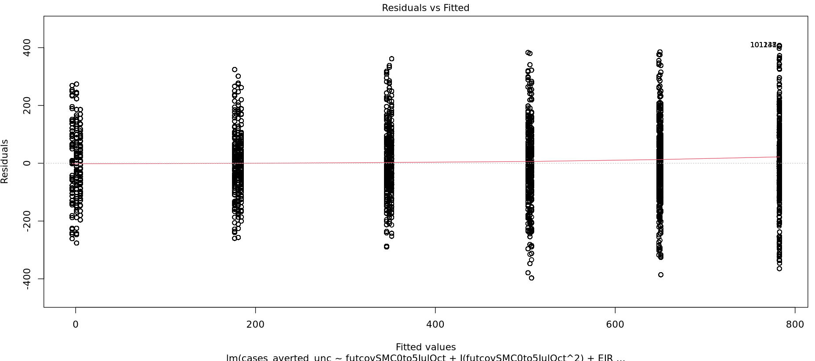
Simple Linear regression - Linearity assumption - SMC

Slide 28
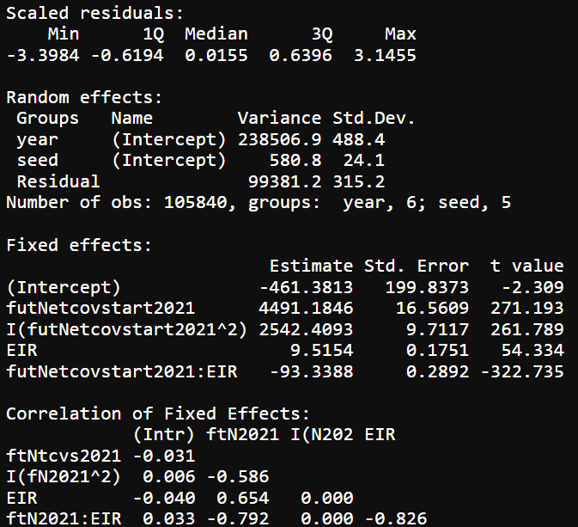
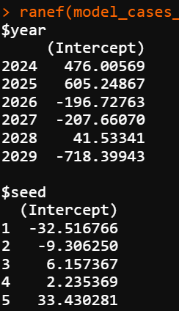
Regression analysis – Linear mixed effects

Slide 29
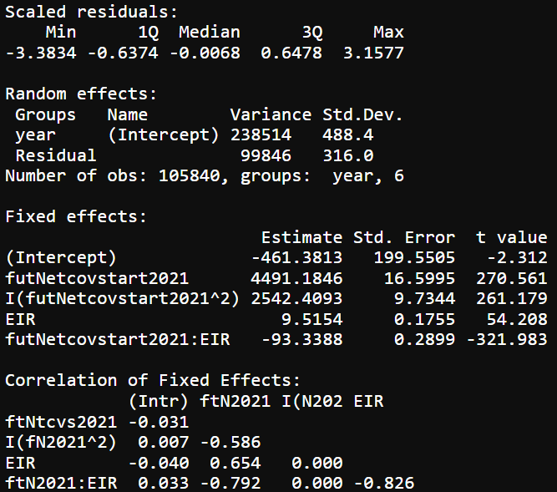
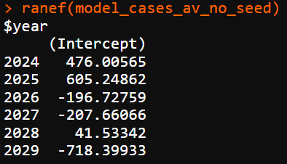
Regression analysis – LLIN (no seed in random effects)

Slide 30
LMM - Linearity assumption

Slide 31

Model comparison

Slide 32
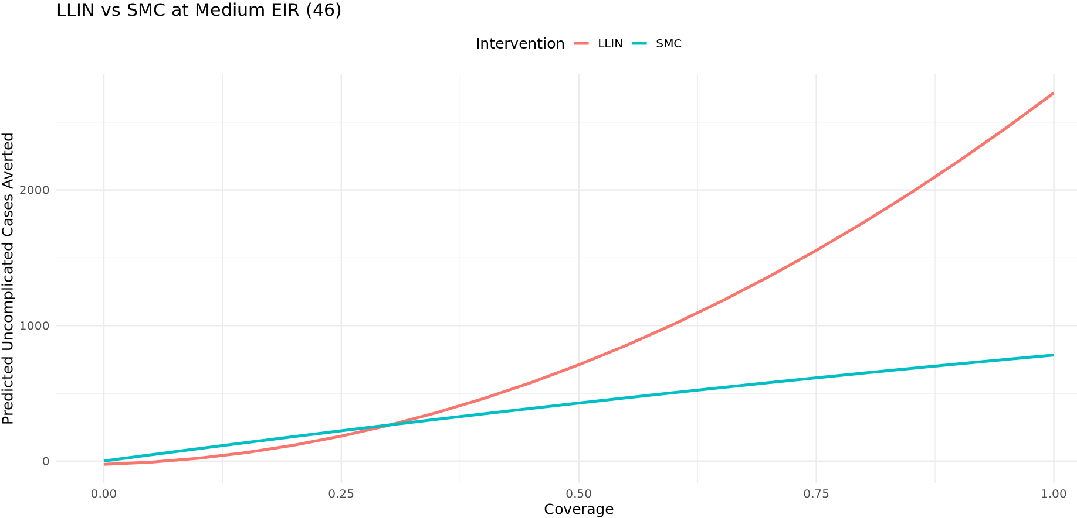
Effect plot of the fitted model: Predicted cases averted over different coverage levels
Visualizing predicted results at the population level with considerations of nonlinearity and interaction

Slide 33
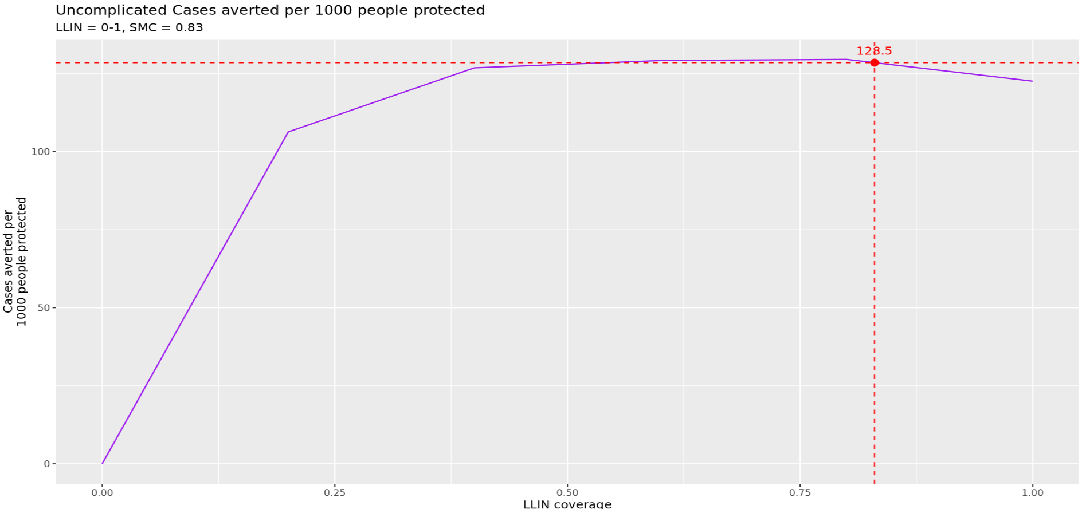
Uncomplicated Cases averted per 1000 people protected

Slide 34
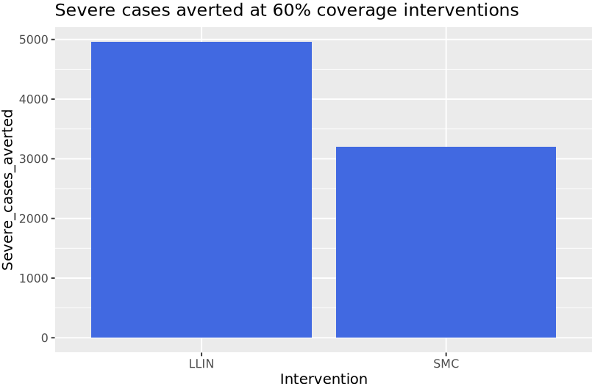
Severe Cases averted

Slide 35
Plot B
mark the current smc coverage and its impact on the llin severe / uncomplicated cases averted per person protected plot. connect it to the cases averted to see what coverage of net achieves that impact (should be low)
Plot A use GP to isolate impact?

